Slide 1
Software Development
Models
Lecture 03
By Okemwa Joshua

Slide 2
Software development process
This is a structure emphasized on software development projects
Its an abstract representation of a process
It involves different software life cycle/models and software processes.
There are different models for such processes and each represent different approach to the tasks and activities that take place during the processes
  The purpose of these processes is to predict quality and productivity for the software developed
By Okemwa Joshua

Slide 3
Models in software development Process
Spiral model
Waterfall model
Prototyping model
Iterative model
  Extreme programming
    Well know process for iterative model
Agile process model
By Okemwa Joshua

Slide 4
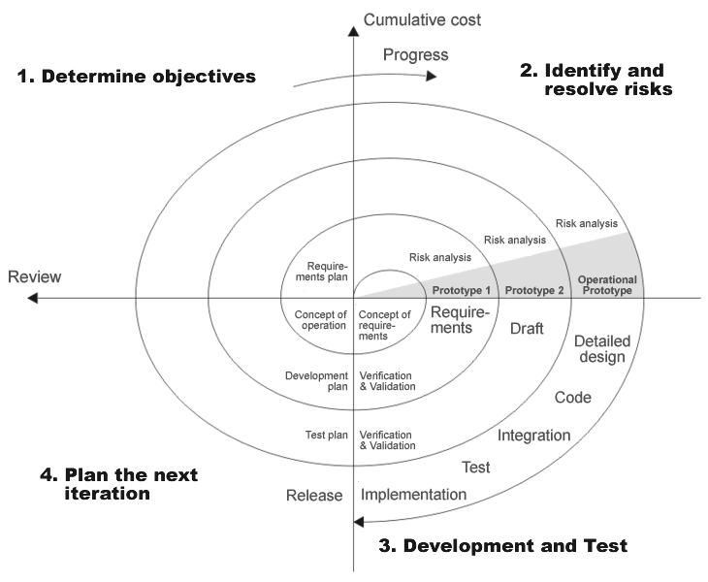
The Spiral model
By Okemwa Joshua

Slide 5
Spiral model
It explicitly embraces prototyping as an iterative approach to software development.
  Start by developing a small prototype.
  Followed by a mini-waterfall process, primarily to gather requirements.
  Then, the first prototype is reviewed.
  In subsequent loops, the project team performs further requirements, design, implementation and review.
  The first thing to do before embarking on each new loop is risk analysis.
  Maintenance is simply a type of on-going development.
By Okemwa Joshua

Slide 6
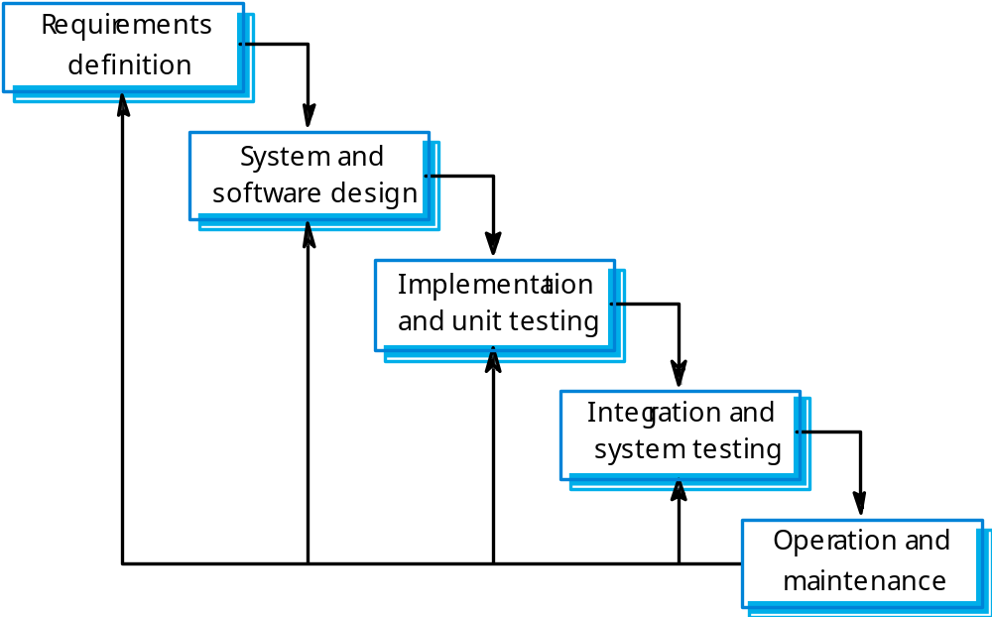
Waterfall model
By Okemwa Joshua

Slide 7
The waterfall model
The classic way of looking at S.E. that accounts for the importance of requirements, design and quality assurance.
  The model suggests that software engineers should work in a series of stages.
  Before completing each stage, they should perform quality assurance (verification and validation).
  The waterfall model also recognizes, to a limited extent, that you sometimes have to step back to earlier stages.
By Okemwa Joshua

Slide 8
Limitations of the waterfall model
  The model implies that you should attempt to complete a given stage before moving on to the next stage
    Does not account for the fact that requirements constantly change.
    It also means that customers can not use anything until the entire system is complete.
  The model makes no allowances for prototyping.
  It implies that you can get the requirements right by simply writing them down and reviewing them.
  The model implies that once the product is finished, everything else is maintenance.
By Okemwa Joshua

Slide 9
Disadvantage Waterfall model
The main disadvantage of the waterfall model is its difficulty in accommodating change after the process is running.
Takes on one phase at a time,
  One phase has to be complete before moving onto the next phase.
By Okemwa Joshua

Slide 10
Waterfall model problems
Inflexible partitioning of the project into distinct stages makes it difficult to respond to changing customer requirements.
  Therefore, this model is only appropriate when the requirements are well-understood and changes will be fairly limited during the design process.
Few business systems have stable requirements.
The waterfall model is mostly used for large systems engineering projects where a system is developed at several sites.
By Okemwa Joshua

Slide 11
Use of Models
Helps define specific characteristics of the software
A good model should;
  Reduce the amount of complexity
  Should be cost effective to build and modify compared to the real thing
  Facilitate the description of complex aspects of the real system
  Portray the requirements elicitation
By Okemwa Joshua

Slide 12
Role of Prototyping
Prototyping is used to;
  Provide feedback to customers and end users
  Improve communication between users and system developers
Many users find it difficult to visualize how the system will work with non executable requirements
By Okemwa Joshua

